Slide 1
🔍 What Students Already Know
should know that a loop can loop for ever or certain amount of times. Students might also know that an if statement can execute code - if a student can use this then great bonus but the main objective todays lesson is using ‘ Loop Until’ to control a program -> I used lots of example of True/False. Loop until tired/not tired. Loop until cold/ not cold, Loop until open/not open
🔁 What's Different in This Program
Loop until total accelerometer ≥ 1.5
This is a "loop until" structure, which means:
The program keeps checking the condition repeatedly.
It does nothing else until the condition becomes true.
Once the condition is true (i.e., total acceleration ≥ 1g), it exits the loop and continues with the next steps (red LED, sound, speech, etc.).
🧠 How to Explain It to Students
You could say:
"Imagine the robot is waiting for a shake. It keeps asking: 'Has someone shaken me hard enough yet?' If not, it just waits. As soon as the shake is strong enough (≥ 1g), it wakes up and starts doing things—turning red, making sounds, and speaking.

Slide 2

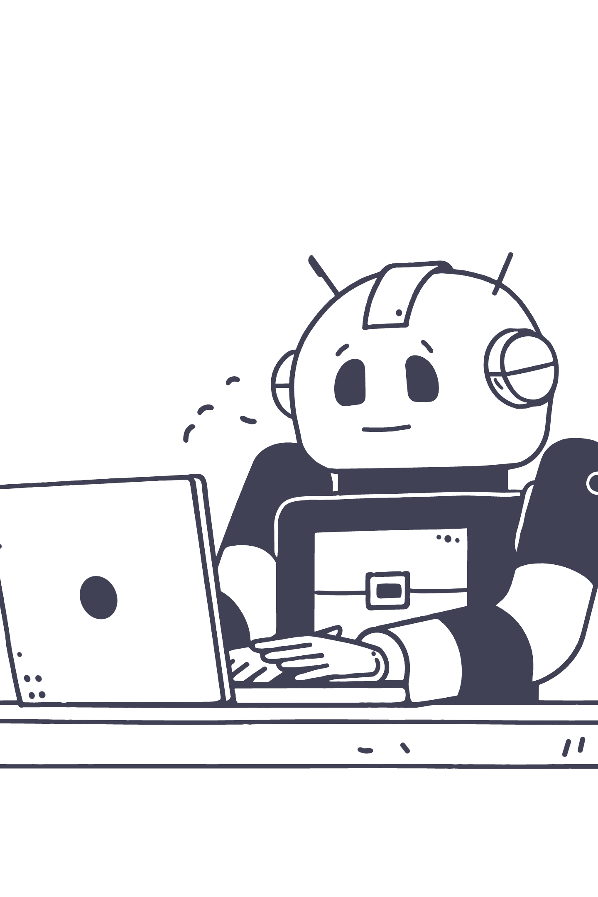
Objectives - Loops
Understand Loops
Control Animations
Event-Driven Programming
Notes:
Discover how loops make programming efficient and bring your Sphero creations to life.

Slide 3
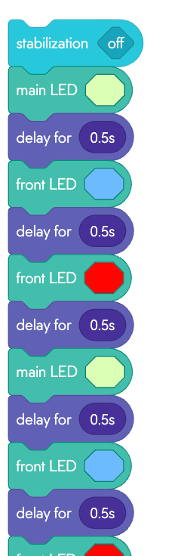
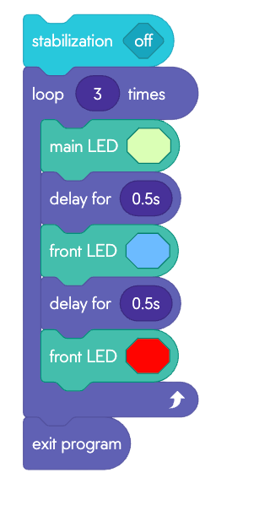
Why Use Loops?
Loops repeat actions automatically, saving time and making code easier to read.
Instead of 8 blocks to flash 8 colors, use 1 loop block + 1 color block for the same result!

Slide 4
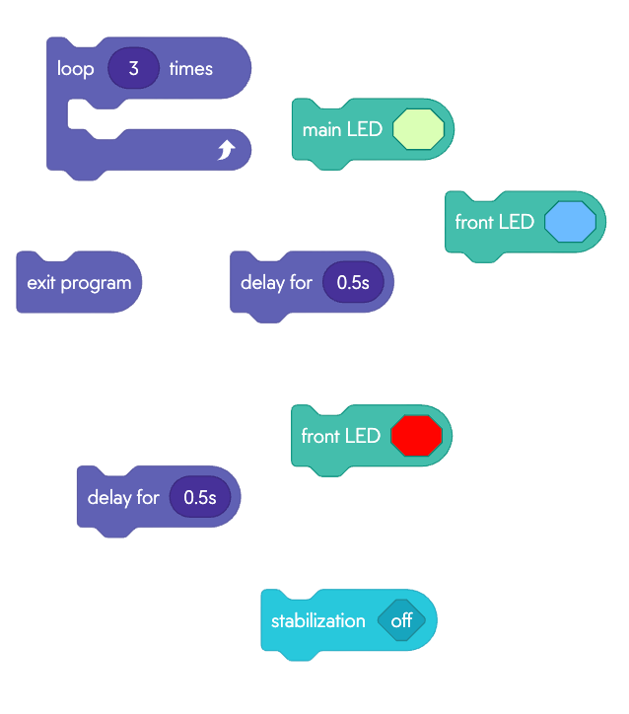
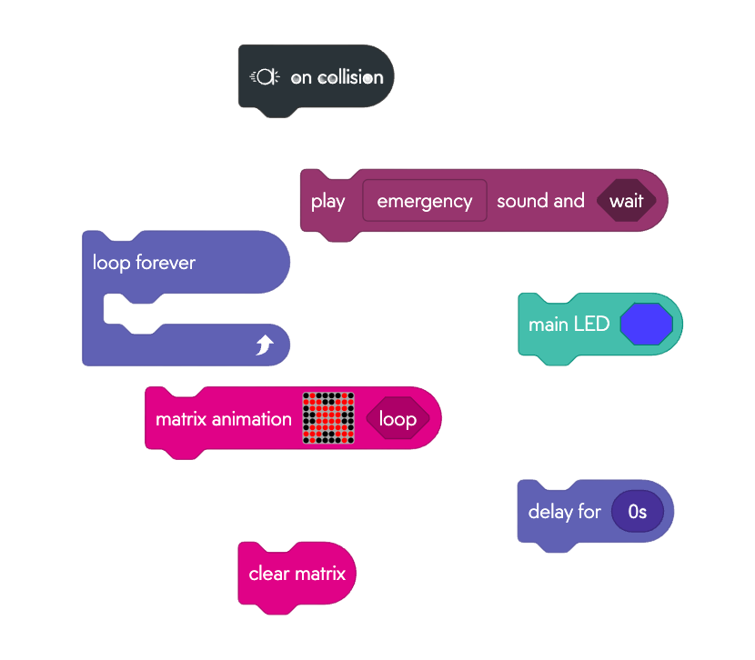
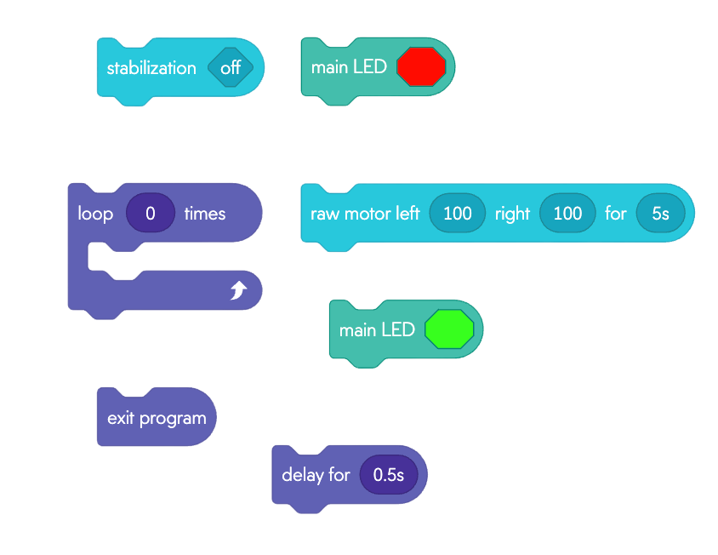
Core Activity: Build & Test
LED Matrix Loop
Spin Sequence
Event Handler Challenge
Create a repeating LED animation.
Trigger actions using Sphero events.
Program Sphero to spin in a loop.
Process: Build on iPad → Connect to Sphero → Test → Disconnect → Next student
FYI - Watch out for any bugs! You might have to edit or remove some code
Notes:
Quik Activity no more than 10mins - students choose one or can try them all and then level up with sounds or lights. Loops at this point don’t really demonstrate any control other than exit.

Slide 5
Mini Plenary: Think & Predict
Loop Count
Spin Direction
What happens if you loop 10 times instead of 5?
What does changing the spin direction do?
Countdown Animation
Event Trigger
How could you use loops to animate a countdown?
What's the benefit of using ON collision instead of WHEN start?

Slide 6
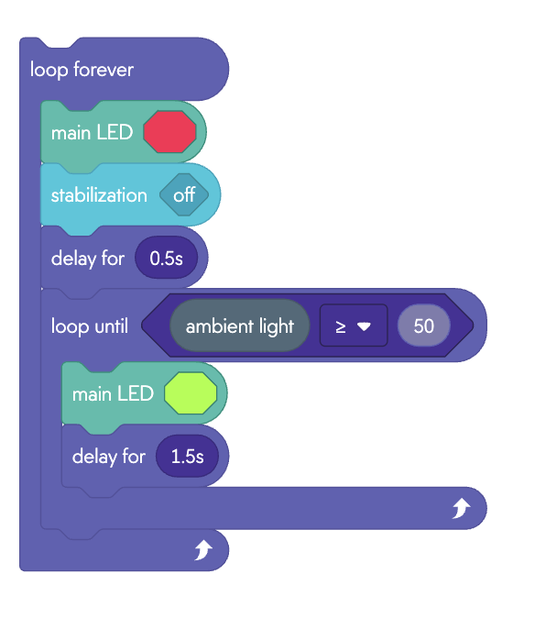
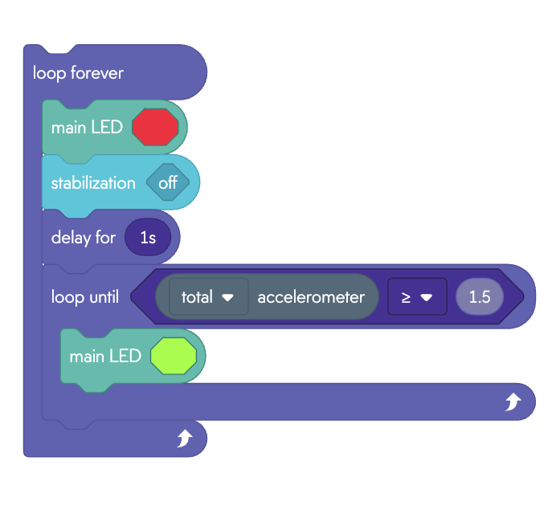
Activity 2: Build & Test
Which sensors are we using?
Notes:
Model This code - This is showing next level of loops using sensor data to evaluate and execute code - Much more advanced than getting a spire to move forever - starting to implement interactivity/dynamic responsive system
Accelerometer - Run program and show sensor data - when you shake sensor graph should show spike in total g above 1.5 g.
Ambient Light - Cover sphero with hand and show sensor data live - should show the highs and lows/ peaks and dips -
The colors in the code are way to show feedback to students in real time on the sphero - Once they’ve mastered can start challenges turning the logic into apps e.g alarm clock or their own choose gamifying .
This Program can be found here . Download to ipad and open up with Sphero edu https://drive.google.com/file/d/1WynrWVDmcUwW607JIIBUFP_dwTOkM9PT/view?usp=drive_link

Slide 7
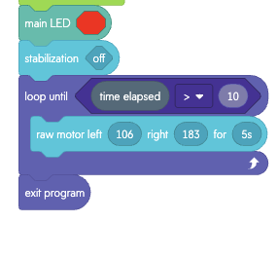
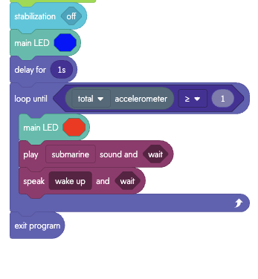
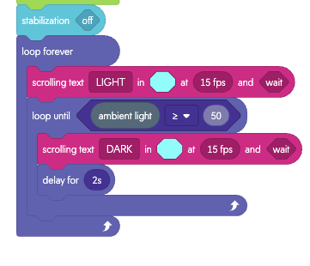
Challenge Cards
Mild Challenge: Timed Motor Burst
️ Hot Challenge: Wake-Up Alarm
️️ Spicy Challenge: Light Sensor
Notes:
MILD CHANGE WAS BUGGY!!! Had to change the operator/inverse the > and < - I would try changing to spicy to see if anyone can debug it or just remove!
There are print outs for this. print has all three challenges - 2 pages per challenge, 1st page has the instructions in sentences, line per code. 2nd page has the blocks but needed to be ordered. Wake-up alarm is a missing a forever loop - forgot to include in booklet…say its a bug they;ve got to fix!!

Slide 8
Plenary: Prove Your Loop Mastery
Assessment Questions
Loop Utility
Control Application
Why are loops useful in programming?
How did you use loops to control the matrix or spin?
Event Trigger
Cross-Curricular
What's one event you used to trigger a loop?
How could loops help in other subjects (e.g., math, music)?

Slide 9
Exit Ticket
Your Loop
Event Handler
Next Idea
What loop did you build today?
What event handler did you try?
What's one new idea you want to test next time?

Slide 10
Advanced Loop Concepts
Use nested loops for complex LED sequences.
Add sound effects to looped animations.
Create a "reaction game" with event handlers and loops.

